Slide 1
Ranking for dialogues
Xinnuo Xu
Supervised by Sungjin Lee, Yizhe Zhang, Lars Liden

Slide 2
Outlines
Amis
Supervised learning
Unsupervised learning
Experiments
Future work

Slide 3
Amis
After releasing their dialogue system (DS) to users, developers can improve the system’s performance by correcting mistakes the system made in dialogues and retraining the DS model on the labeled data.
However, going through all dialogues is time consuming. So we need a ranker to detect dialogues with lower quality automatically to make this dialogue learning process with human-in-the-loop efficient.
Also, gathering labeled data for supervised learning is time consuming. Therefore, we are building a unsupervised pointwise neural ranker

Slide 4
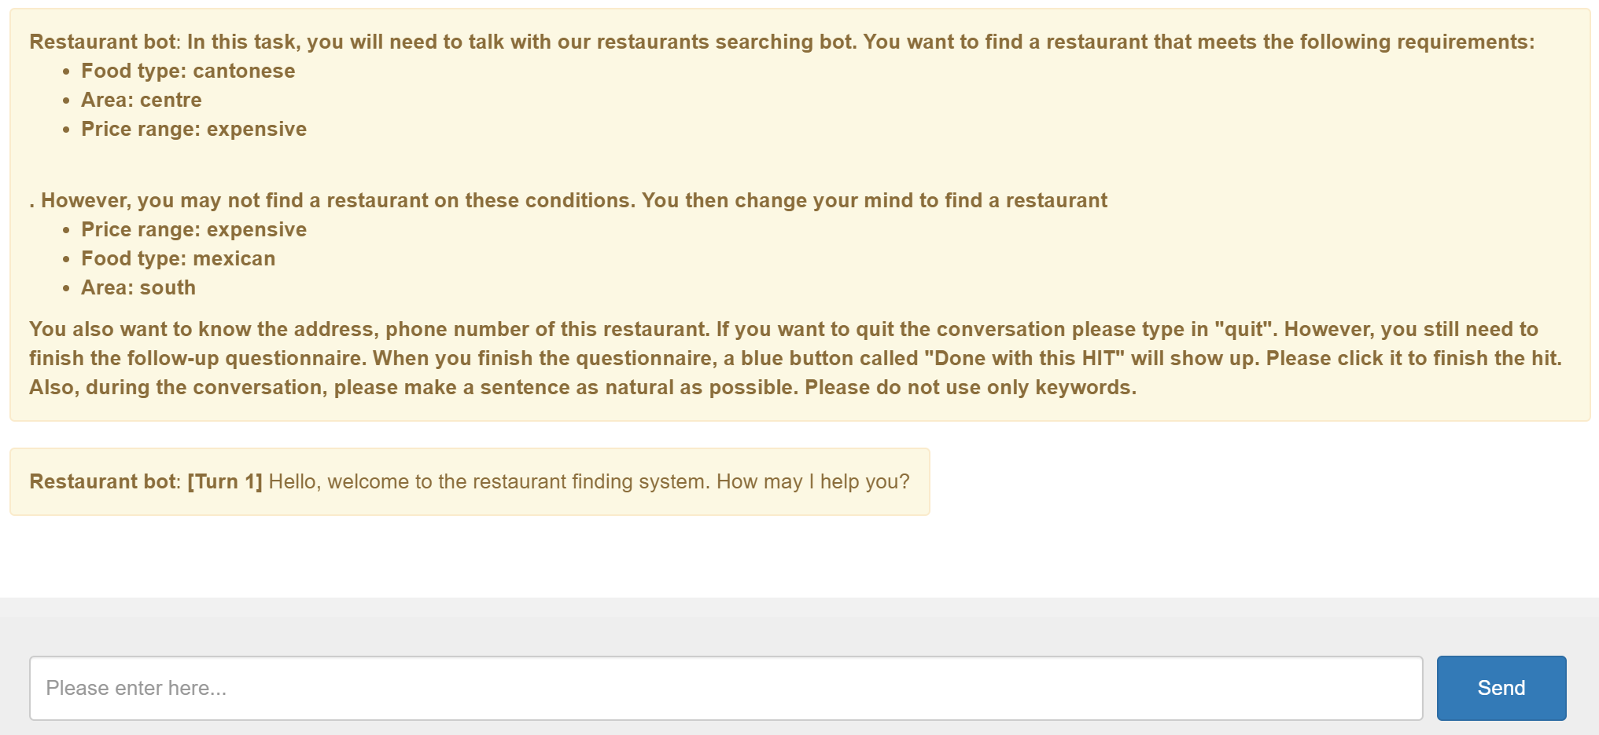
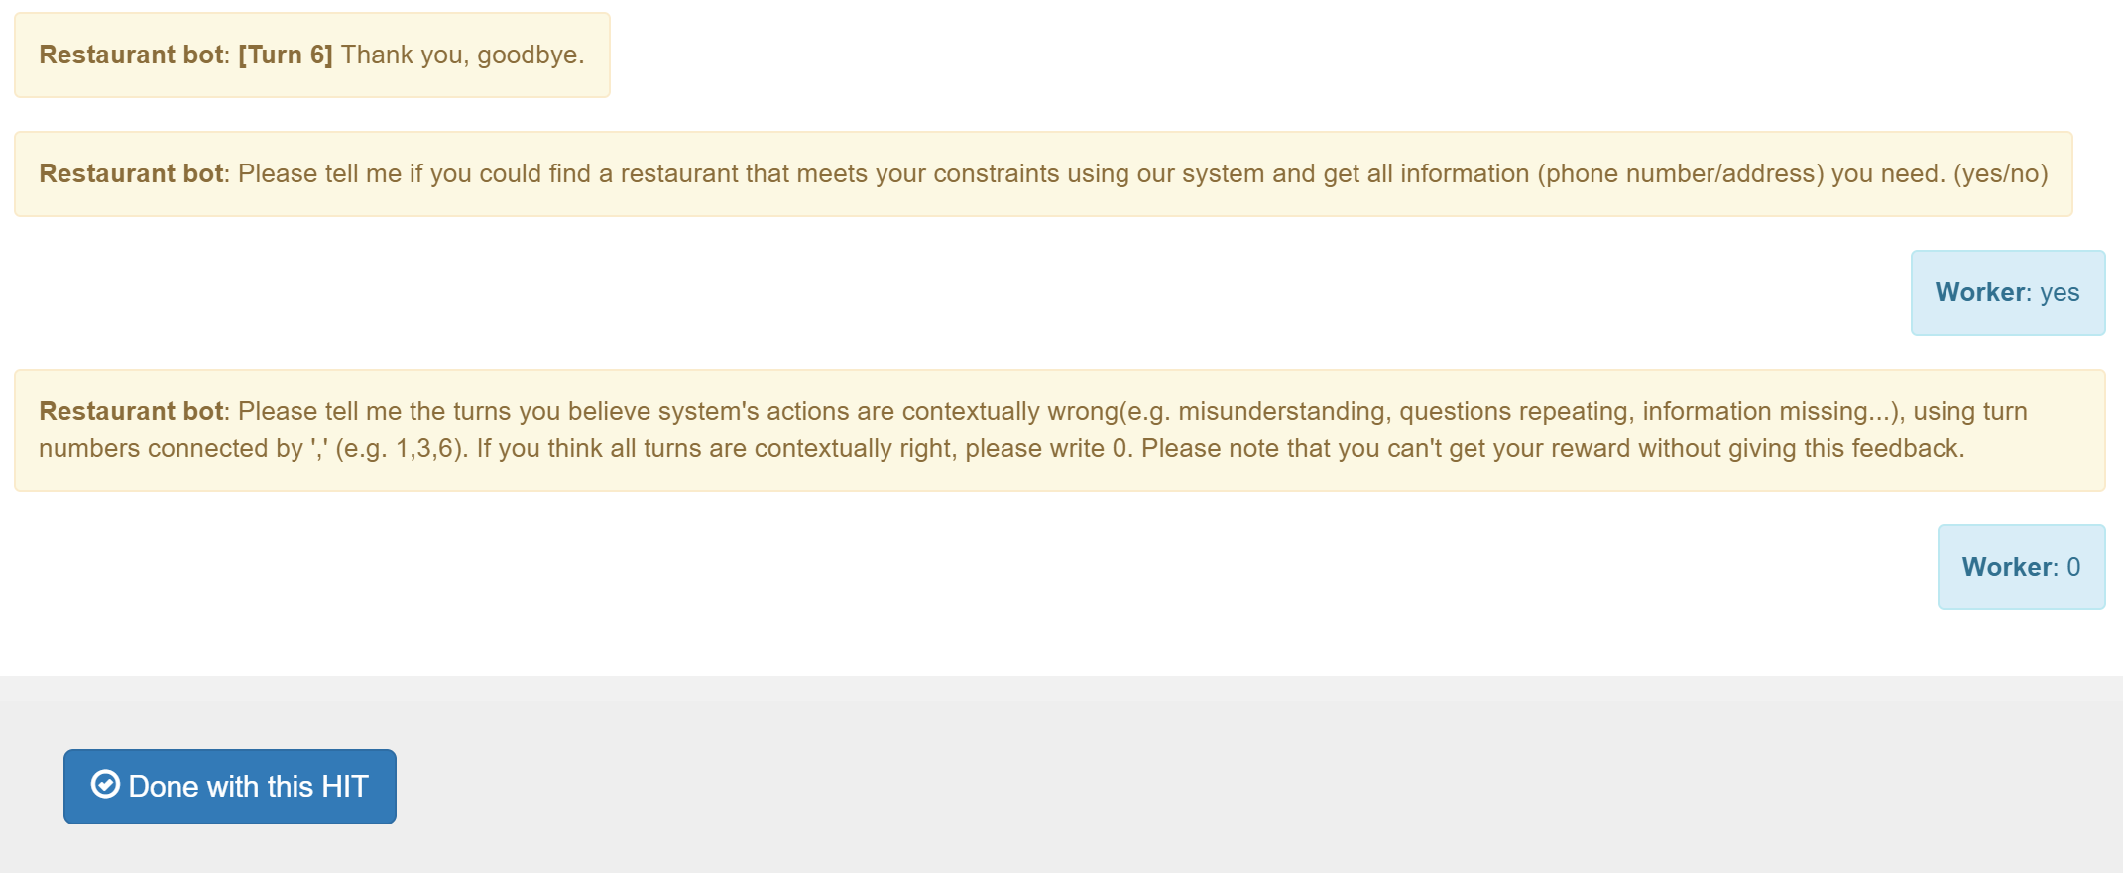


Supervised learning
Data Collection
Tool
Amazon Mechanical Turk
Cambridge Pydial restaurant finding bot
Tasks for users
Talk with Pydial restaurant finding bot to achieve a given goal
Do not use simple utterances
Label the goal is achieved or not
Label the contextually wrong turns

Slide 5
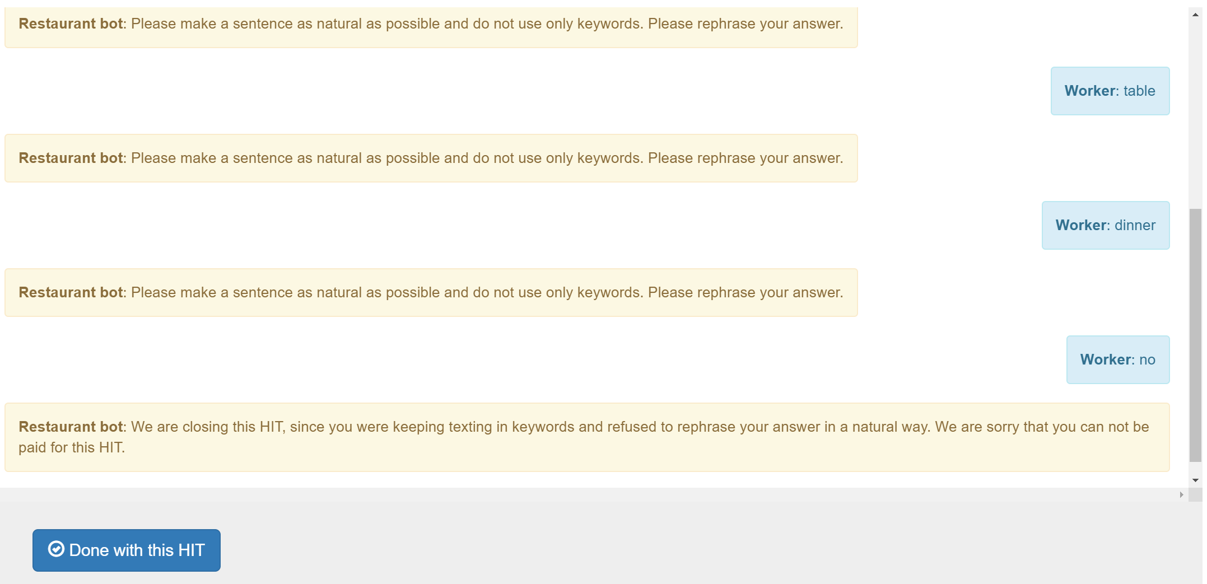
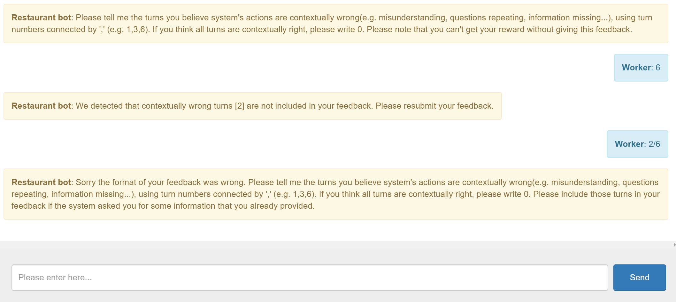
Supervised learning
Data Collection
Tricks
Force users to use natural and complex utterances
Check the format of feedbacks
Check the quality of feedbacks
Force users to stop labeling when they labeled 20 dialogues already

Slide 6
Supervised learning
Data Statistics
1 turn = [sys, user]
Ratio of repeats = Num of identity utterances/length of the dialogue
 | Positive examples | Negative examples
Definition | Task_finish=Yes and Labels=0 | Task_finish=Yes and Labels!=0 Task_finish=No
Num of dialogues | 1470 | 1896
Avg length | 5.85 turns | 8.26 turns
Ratio of repeats

Slide 7
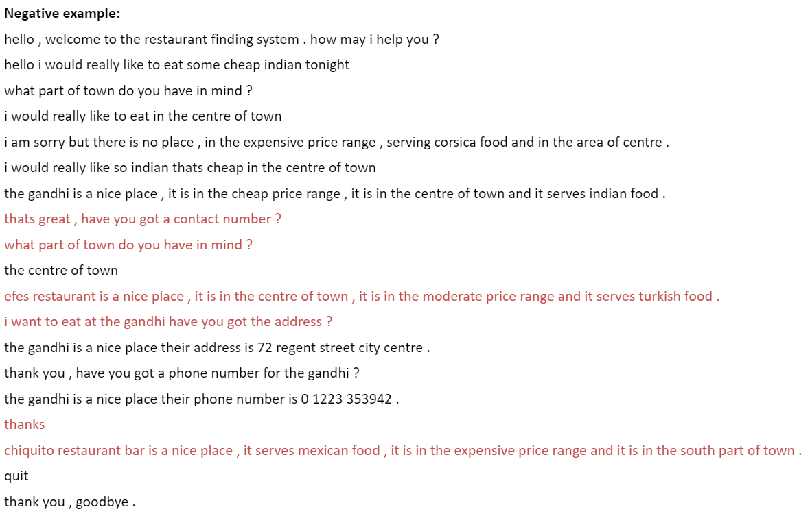
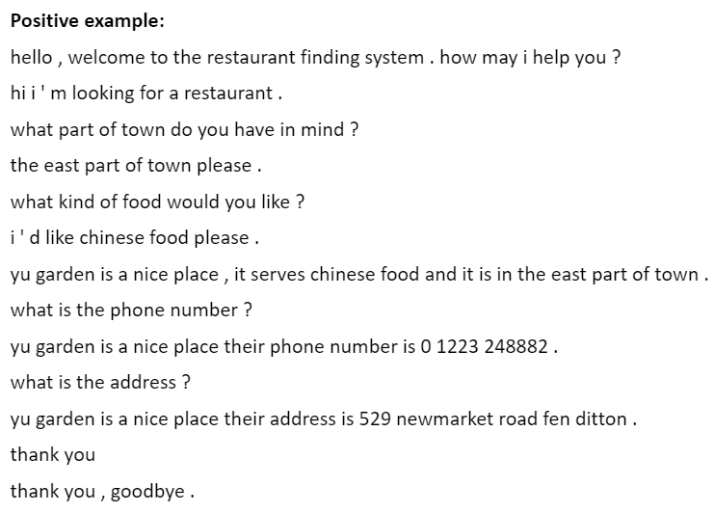
Supervised learning

Slide 8
Supervised learning
Data preparation
Building balanced dataset for training/testing
Data preprocessing
Lowercase
Tokenize
 | Positive | Negative
Training set | 1000 | 1000
Validation set | 100 | 100
Testing set | 200 | 200

Slide 9
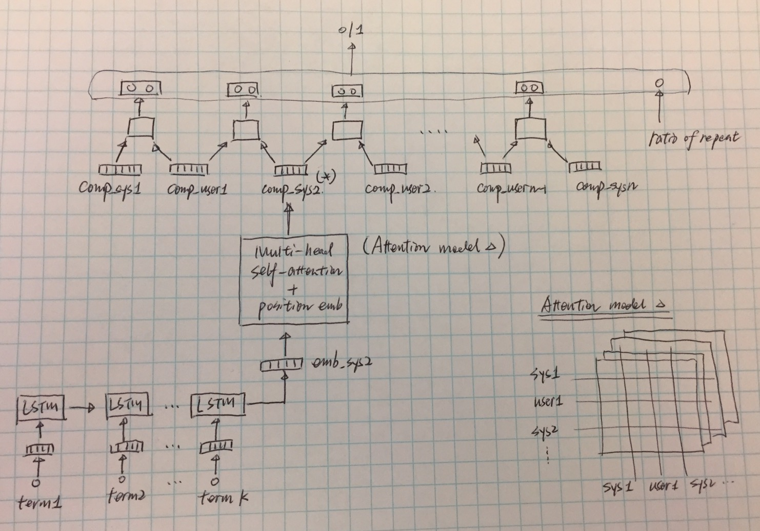
Supervised learning
Model: Multi-heads self-attention + position embedding

Slide 10
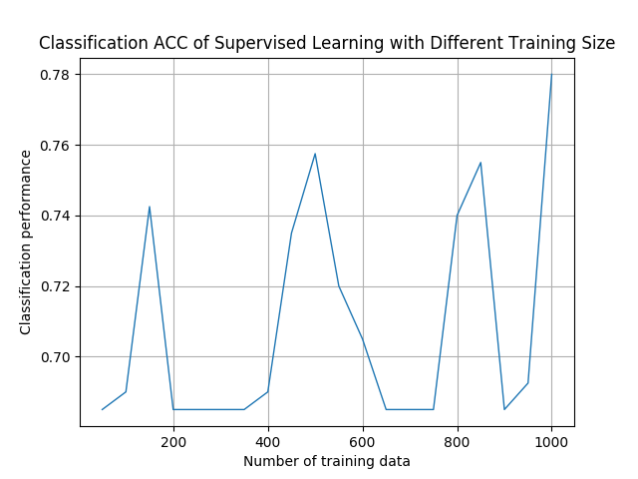
Supervised learning
Evaluation
Classification ACC

Slide 11
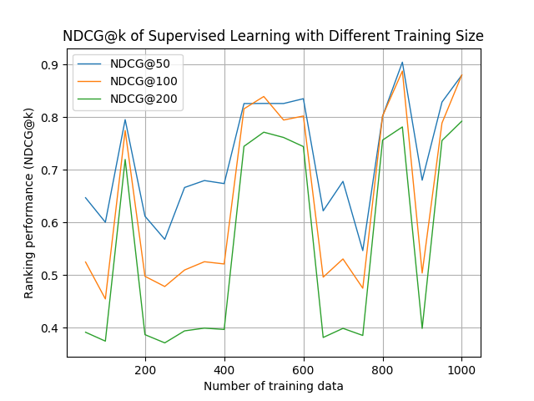
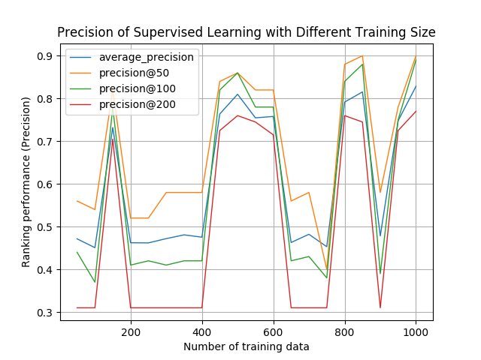
Supervised learning
Evaluation
Ranking metrics

Slide 12

Unsupervised learning
Goal
Given only gold dialogues (references during the DS construction) and the DS and giving a ranker that can detect user-to-system dialogues with lower quality
Approach
Train a user simulator to talk with Pydail restaurant finding bot and collect conversations as negative examples
Take gold dialogues as positive examples
Train a discriminator to detect dialogues with lower quality

Slide 13
Unsupervised learning
Models
Seq2seq user simulator pre-trained on Maluuba (Pretrained-US)
Seq2seq user simulator fine tuned on Gold dialogues (Finetune-US)
Stepwised seq2seq user simulator (Stepwised-US)
GANs

Slide 14
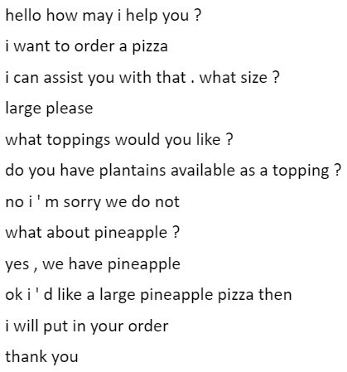
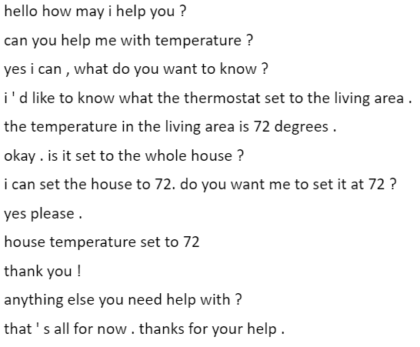
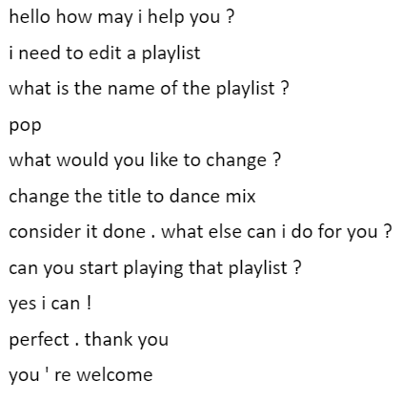
Pre-training of seq2seq user simulator
Data
Pre-training data: multi-domain Maluuba
 | Training set | Validation set | Testing set
Num of Dials | 38000 | 1000 | 1000
Num of sentences | 394821 | 10411 | 10370

Slide 15
Pre-training of seq2seq user simulator
Model choosing
Attention based LSTM
 | Attention | Copy network | HRED
BLEU-1-2-3-4 | 13.13/7.77/5.56/4.21 | 12.46/7.48/5.42/4.19 | 13.53/8.03/5.65/4.16
Distinct-1 | 0.089 | 0.086 | 0.072
Distinct-2 | 0.287 | 0.270 | 0.217
Distinct sentence | 0.521 | 0.488 | 0.357

Slide 16
Pre-training of seq2seq user simulator
Model hyper parameters (pre-training)
Layers: 1
Units: LSTM
Word Embedding size: 256
Rnn hidden size: 128
Dropout: 0.2
Maximum dialogue length: 5
Optimization:adam
Learning_rate: 0.0001
Beam search: 5

Slide 17
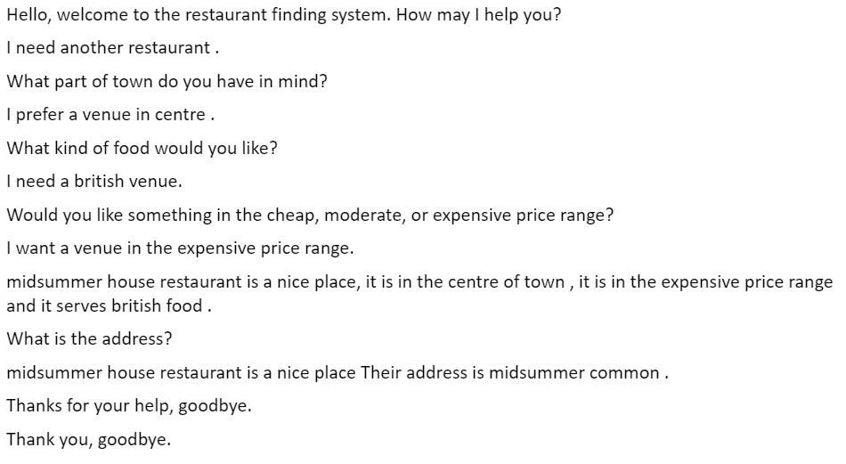
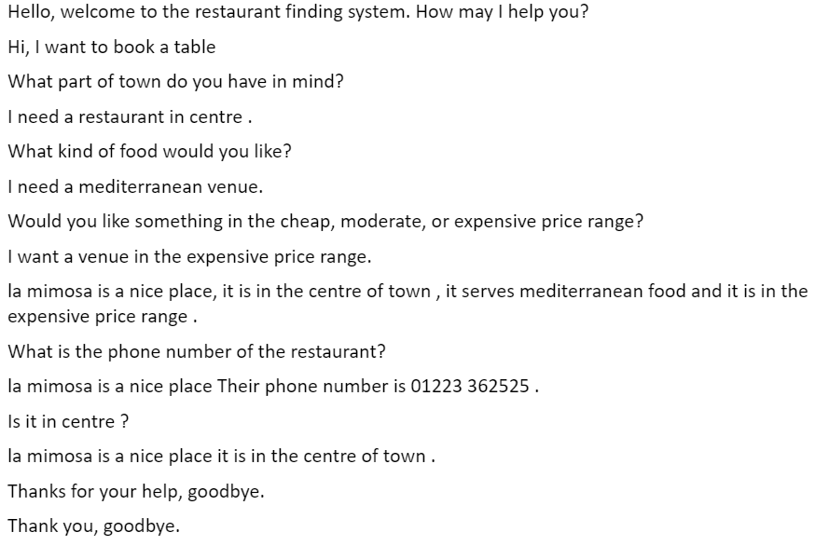
Fine tuning of seq2seq user simulator
Data
Training data: 100 Gold dialogues generated by rule-based user simulator and restaurant finding system offered in Pydail
 | Training set | Validation set
Num of Dials | 80 | 20
Num of sentences | 1032 | 249

Slide 18
Fine tuning of seq2seq user simulator
Model hyper parameters (training)
Layers: 1
Units: LSTM
Word Embedding size: 256
Rnn hidden size: 128
Dropout: 0.2
Maximum dialogue length: 5
Optimization:adam
Learning_rate: 0.00001
Beam based random sampling: 5

Slide 19
Stepwise negative example generation (SNEG)
Training for discriminator
Data
Negative examples generation
During training process of generator:
Save a model for each 6 epochs
20 models in total
Collect 100 conversations between each model and Pydial restaurant finding bot (100 * 20)
Positive examples
Duplication of 100 gold dialogues (100 * 20)
 | Training set | Validation set
Num of Dials | 1600 | 400

Slide 20
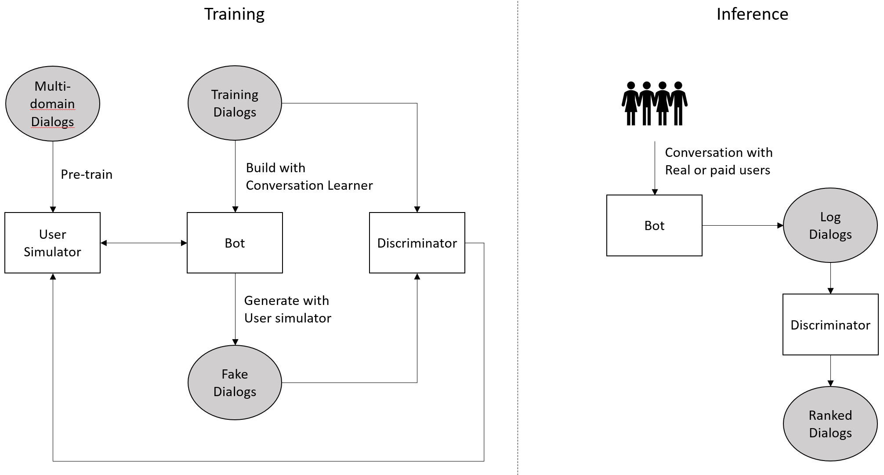
GANs based negative example generation (GNEG)
Motivation
GANs training procedure matches well the final ranking task
Goal of generator: Fool the discriminator
Goal of discriminator: Distinguish fake dialogues from true dialogues
GAN set up

Slide 21
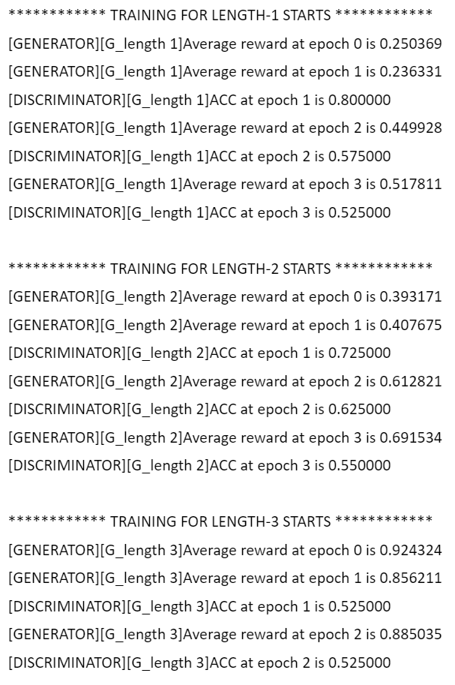
GANs based negative example generation (GNEG)
Motivation
GANs training procedure matches well the final ranking task
Goal of generator: Fool the discriminator
Goal of discriminator: Distinguish fake dialogues from true dialogues
GAN set up
Dialogue Generator:
Attention LSTM based user simulator (pre-trained on Maluba data)
Pydial restaurant finding bot
Discriminator: Multi-heads self-attention + position embedding
Training method: Policy gradients
Training pipline
Incrementally learning: learn to generate turn by turn

Slide 22
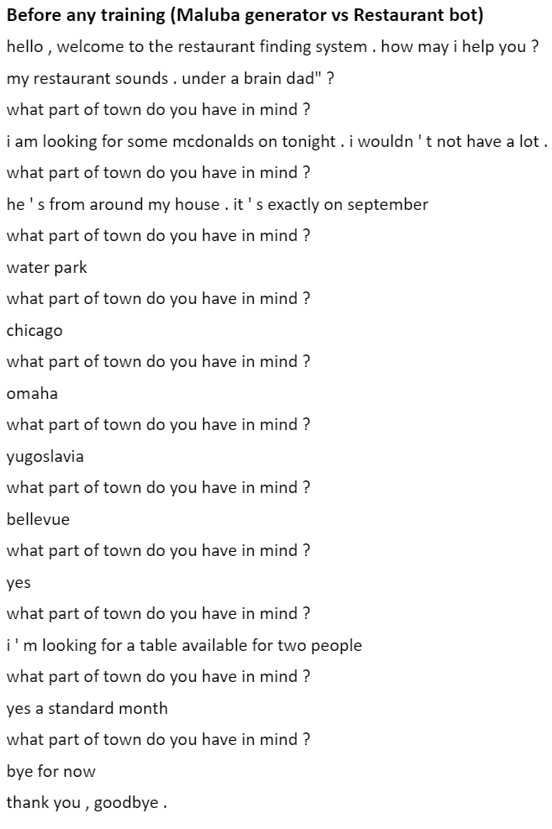
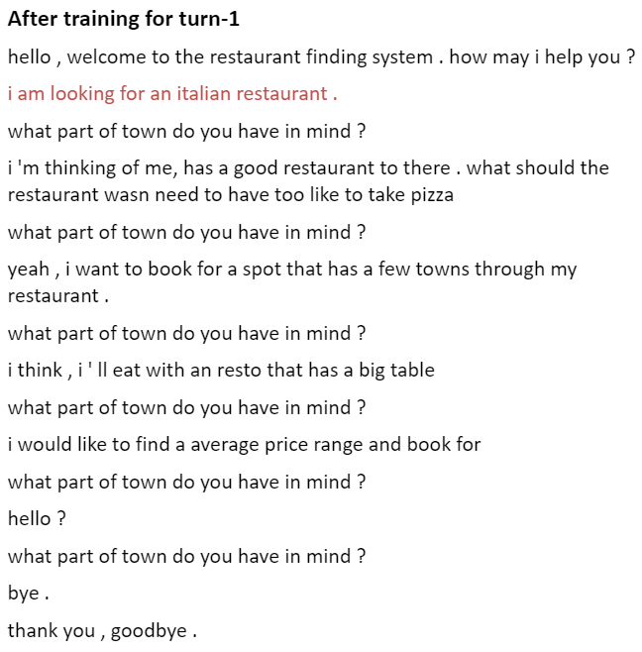
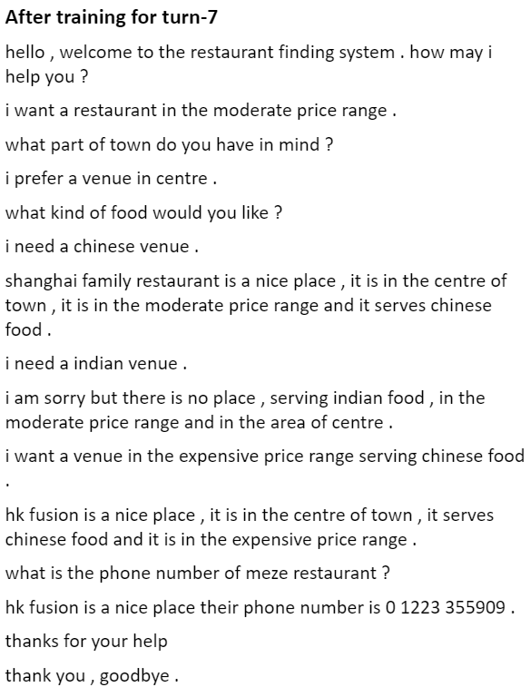
GANs based negative example generation (GNEG)
Dialogues generated by models trained for different turns

Slide 23
Experiments
Evaluation metrics
Classification accuracy: correctly labeled data / all data
NDCG: Discounted cumulative gain at position N
P@n: Precision and recall
 | Cls ACC | NDCG@50 | NDCG@100 | NDCG@200 | P@50 | P@100 | P@200
Supervised | .7800 | .8799 | .8802 | .7925 | .9000 | .8900 | .7700
LSTM-US | .7250 | .8095 | .8066 | .7550 | .7400 | .7700 | .7200
GAN | .7375 | .8531 | .8165 | .7607 | .8600 | .8100 | .7400

